Slide 1
What Is

Slide 2
Finally let’s consider more forms of love. First, the love shown when one teaches. As a teacher, others will consider the words spoken and how they are spoken.

Slide 3
Finally let’s consider more forms of love. First, the love shown when one teaches. As a teacher, others will consider the words spoken and how they are spoken.
They will consider the scripture used and how well the speaker makes the points he is attempting to make and whether or not they apply or are used in error.

Slide 4
Considering how important it is, why does anyone present a lesson, talk, or sermon?

Slide 5
Considering how important it is, why does anyone present a lesson, talk, or sermon?
We do so because we love those who hear those messages. We love them so we work on material and strive to use scripture as best we can to make that material focused and easily understood.

Slide 6
It’s not for the money. If it was, I’d be speaking for a mega church, making people feel good, and use little if any scripture, but then how would you grow?

Slide 7
It’s not for the money. If it was, I’d be speaking for a mega church, making people feel good, and use little if any scripture, but then how would you grow?
Other examples of love are visiting those who are unable to worship as they did, caring for those who are sick, giving them cards/flowers/food, encouraging the growth of the brethren, and weeping with those who are in mourning. All of these are love.

Slide 8
Why do we speak to others about the bible? Because we love our fellow man and their soul.

Slide 9
Why do we speak to others about the bible? Because we love our fellow man and their soul.
Through doing all of these things, we show that we love God.

Slide 10
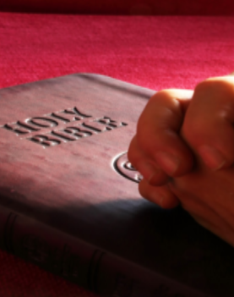
And one final necessary way is to be baptised. Mark 16: 14-16

Slide 11
Later He appeared to the eleven as they sat at the table; and He rebuked their unbelief and hardness of heart, because they did not believe those who had seen Him after He had risen.
And He said to them, “Go into all the world and preach the gospel to every creature. He who believes and is baptized will be saved; but he who does not believe will be condemned

Slide 12
We show God that we love Him when we obey the gospel and are baptized.
We show God that we love Him when we are saved, and we show God that we love Him when we, through living a godly life of obedience to Him, maintain that salvation.
That is love.

Slide 13
We show God that we love Him when we obey the gospel and are baptized.
We show God that we love Him when we are saved, and we show God that we love Him when we, through living a godly life of obedience to Him, maintain that salvation.
That is love.
Thank you for your attention through this series.

