Slide 1
What Is

Slide 2
We mentioned work and action, but growth is another example of love

Slide 3
We mentioned work and action, but growth is another example of love
Claiming to be His own not enough. We all can and should grow.
Psalm 119: 97-104

Slide 4
Oh, how I love Your law!
It is my meditation all the day.
You, through Your commandments, make me wiser than my enemies;
For they are ever with me.
I have more understanding than all my teachers,
For Your testimonies are my meditation.

Slide 5
I understand more than the ancients,
Because I keep Your precepts.
I have restrained my feet from every evil way,
That I may keep Your word.
I have not departed from Your judgments,
For You Yourself have taught me.

Slide 6
How sweet are Your words to my taste,
Sweeter than honey to my mouth!
Through Your precepts I get understanding;
Therefore I hate every false way.

Slide 7
How does one grow? Through the scripture. As we better our lives daily through scriptural wisdom, David considers such as blessed in Psalm 1: 1, but knowledge of scripture is not enough.
One way to grow is through the failures of others, such as David’s sin with Bathsheba

Slide 8
Let’s consider another example of how our lives can be improved through scripture, Isaiah 11: 1-3

Slide 9
There shall come forth a Rod from the stem of Jesse,
And a Branch shall grow out of his roots.
The Spirit of the Lord shall rest upon Him,
The Spirit of wisdom and understanding,
The Spirit of counsel and might,

Slide 10
The Spirit of knowledge and of the fear of the Lord.
His delight is in the fear of the Lord,
And He shall not judge by the sight of His eyes,
Nor decide by the hearing of His ears;

Slide 11
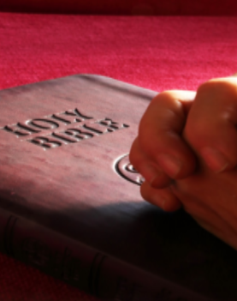
We know this passage is speaking of Jesus, however I’d like us to focus on the Spirit of the Lord. The spirit of wisdom, understanding, counsel, might.
That Spirit is the Holy Spirit, which inspired the men to write what we now know as the bible.

Slide 12
Both directly through prophets [2 Peter 1: 20-21] or through those who would write the new testament [John 14: 26]

Slide 13
Both directly through prophets [2 Peter 1: 20-21] or through those who would write the new testament [John 14: 26]
It is through that word that we see what awaits us after this life is over. We also see our hope in that word, not just hope, but also the fire that ignites in our hearts to do more, to learn more, to love more.
That is love.

