Slide 1
What Is

Slide 2
What does the bible say about love?

Slide 3
What does the bible say about love?
First, let’s consider God’s love. Unlike human love, God won’t “fall out” of love with us just because He’s not happy, or bored.

Slide 4
What does the bible say about love?
First, let’s consider God’s love. Unlike human love, God won’t “fall out” of love with us just because He’s not happy, or bored.
His is a forgiving love, one of patience and not of hypocrisy or selfishness
Jeremiah 29: 10-14

Slide 5
For thus says the Lord: After seventy years are completed at Babylon, I will visit you and perform My good word toward you, and cause you to return to this place. For I know the thoughts that I think toward you, says the Lord, thoughts of peace and not of evil, to give you a future and a hope.

Slide 6
Then you will call upon Me and go and pray to Me, and I will listen to you. And you will seek Me and find Me, when you search for Me with all your heart. I will be found by you, says the Lord, and I will bring you back from your captivity;
I will gather you from all the nations and from all the places where I have driven you, says the Lord, and I will bring you to the place from which I cause you to be carried away captive.

Slide 7
Israel continues to turn its back on God, who remembers His own people, and allowed repeatedly for them to return to Him. Why? Because God keeps His promises. To them then and to us today
1 John 4: 7-12

Slide 8
Beloved, let us love one another, for love is of God; and everyone who loves is born of God and knows God. He who does not love does not know God, for God is love. In this the love of God was manifested toward us, that God has sent His only begotten Son into the world, that we might live through Him.

Slide 9
In this is love, not that we loved God, but that He loved us and sent His Son to be the propitiation for our sins. Beloved, if God so loved us, we also ought to love one another.
No one has seen God at any time. If we love one another, God abides in us, and His love has been perfected in us.

Slide 10
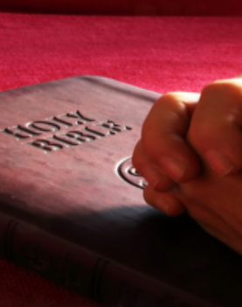
From the beginning of time until now, we see God’s love in His plan for salvation.

Slide 11
From the beginning of time until now, we see God’s love in His plan for salvation.
God’s wasn’t a fleeting emotion, it was a calculated decision. A decision that allows us to obey Him and be blessed with eternal life.
That is love.

