Slide 1
Knowledge

Slide 2
“A wise man will hear and increase learning,
And a man of understanding will attain wise counsel,
To understand a proverb and an enigma,
The words of the wise and their riddles.
The fear of the Lord is the beginning of knowledge,
But fools despise wisdom and instruction.“ Proverbs 1: 5-7

Slide 3
God is our almighty creator, so what better way to gain knowledge than to learn it directly from the source of knowledge?

Slide 4
God is our almighty creator, so what better way to gain knowledge than to learn it directly from the source of knowledge?
One of the biggest problems facing Christianity today is exactly that- a lack of knowledge of God’s word. You don’t have to look far to see proof.

Slide 5
Men have made businesses out of fooling those of the faith by misapplying scripture to what’s happening around them today, and so many believe said misapplication because they don’t know better.

Slide 6
Men have made businesses out of fooling those of the faith by misapplying scripture to what’s happening around them today, and so many believe said misapplication because they don’t know better.
Christians are allowing nearly anything to be taught in their churches in the name of tolerance and understanding. They care more about being more modern than traditional or old fashioned churches.

Slide 7
Ironically none of this is new. This supposed “modernization” has taken place since the first century [long before, actually] 2 Kings 17: 7-12

Slide 8
For so it was that the children of Israel had sinned against the Lord their God, who had brought them up out of the land of Egypt, from under the hand of Pharaoh king of Egypt; and they had feared other gods, and had walked in the statutes of the nations whom the Lord had cast out from before the children of Israel, and of the kings of Israel, which they had made.

Slide 9
Also the children of Israel secretly did against the Lord their God things that were not right, and they built for themselves high places in all their cities, from watchtower to fortified city. They set up for themselves sacred pillars and wooden images on every high hill and under every green tree.

Slide 10
There they burned incense on all the high places, like the nations whom the Lord had carried away before them; and they did wicked things to provoke the Lord to anger, for they served idols, of which the Lord had said to them, “You shall not do this thing.”

Slide 11
Time and time again they would worship the gods of those around them, completely turning their back on the one who saved them from their own choices. The most egregious example being Aaron’s excuse to Moses regarding the golden calf. Exodus 32: 21-24

Slide 12
“And Moses said to Aaron, “What did this people do to you that you have brought so great a sin upon them?”

Slide 13
So Aaron said, “Do not let the anger of my lord become hot. You know the people, that they are set on evil. For they said to me, ‘Make us gods that shall go before us; as for this Moses, the man who brought us out of the land of Egypt, we do not know what has become of him.’ And I said to them, ‘Whoever has any gold, let them break it off.’ So they gave it to me, and I cast it into the fire, and this calf came out.”

Slide 14
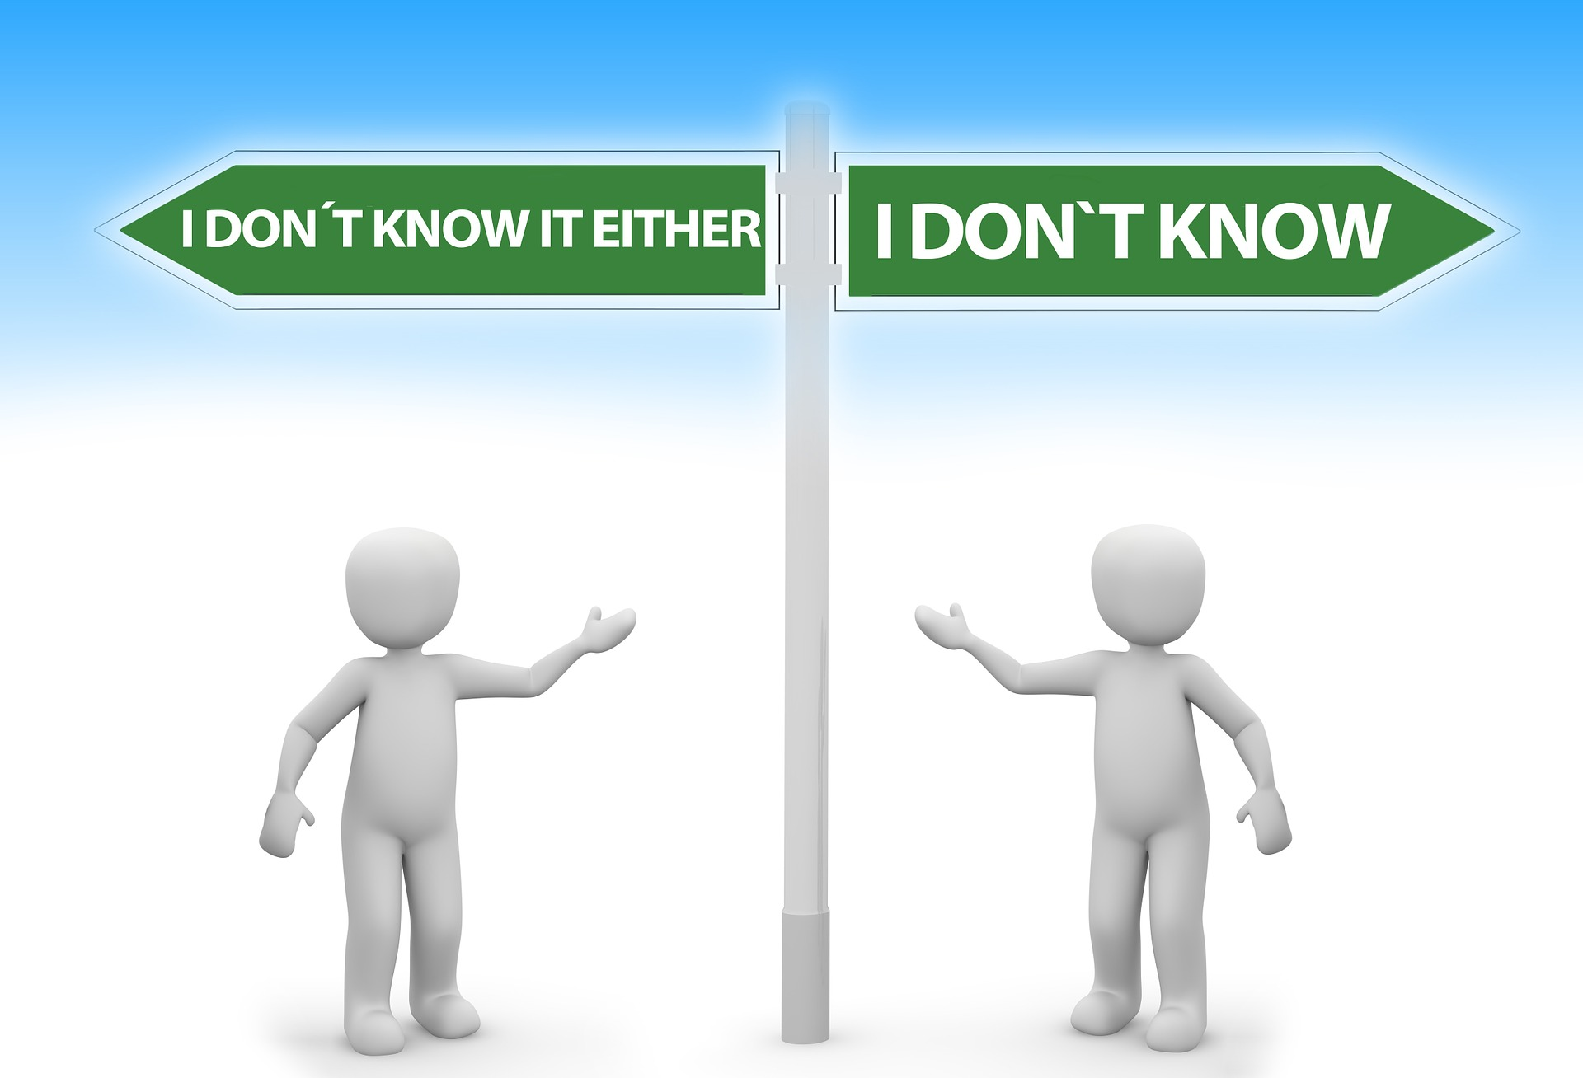
The people are set on evil. Can that be said about Christians today? I certainly hope not. However, all it takes for evil to win is for those who are good to not fight against it, and seeing the state of Christianity today, enough aren’t pulling their weight.

Slide 15
One of the biggest reasons younger people are leaving the church, that you won’t hear about often is parents aren’t doing their best to raise their children in the training and admonition of the Lord, Ephesians 6: 4. I know that’s said about fathers, but both parents must do so.

Slide 16
One of the biggest reasons younger people are leaving the church, that you won’t hear about often is parents aren’t doing their best to raise their children in the training and admonition of the Lord, Ephesians 6: 4. I know that’s said about fathers, but both parents must do so.
Both parents must, as found in Deuteronomy 6: 6-9

Slide 17
And these words which I command you today shall be in your heart. You shall teach them diligently to your children, and shall talk of them when you sit in your house, when you walk by the way, when you lie down, and when you rise up. You shall bind them as a sign on your hand, and they shall be as frontlets between your eyes. You shall write them on the doorposts of your house and on your gates.

Slide 18
If parents don’t have the time to read the bible with their children, to pray with them, sing songs of praise to the Lord with them, to teach them, can their kids know better than what they’re being taught as gospel by their friends? Their schools?

Slide 19
If parents don’t have the time to read the bible with their children, to pray with them, sing songs of praise to the Lord with them, to teach them, can their kids know better than what they’re being taught as gospel by their friends? Their schools?
In my biology class in university, our teacher intentionally added the question “How was the universe created?” With an intelligent designer added as a wrong answer.

Slide 20
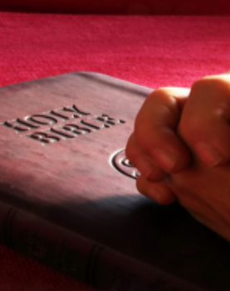
The world is full of all kinds of evil being accepted as good. Of people focused strictly on their own desires and narcissism. Do we have enough knowledge as Christians to explain exactly why their actions are evil? Do we even care?

Slide 21
The world is full of all kinds of evil being accepted as good. Of people focused strictly on their own desires and narcissism. Do we have enough knowledge as Christians to explain exactly why their actions are evil? Do we even care?
God allows even those who profess His name to be ignorant if they want to be. The excuse for said ignorance is irrelevant.

Slide 22
What is relevant, and what we will eventually answer for, is whether or not we are working diligently each day to grow in faith and knowledge of God’s word. If not, we only have ourselves to blame.

Slide 23
If those who know little if anything about the bible try to teach others, they, as those in Luke 6: 39-40

Slide 24
And He spoke a parable to them: “Can the blind lead the blind? Will they not both fall into the ditch? A disciple is not above his teacher, but everyone who is perfectly trained will be like his teacher.

Slide 25
This is in regards to hypocrisy. We must make sure that we know enough, and have trained ourselves enough to know we’re capable of teaching. Otherwise, we will lead both others and ourselves into said ditch.

Slide 26
This is in regards to hypocrisy. We must make sure that we know enough, and have trained ourselves enough to know we’re capable of teaching. Otherwise, we will lead both others and ourselves into said ditch.
I’ve never trained to be a lifeguard.
If I tried to save someone who is drowning in deep, choppy water, I would very likely drown as well.

Slide 27
To be able to save someone would require years of training, developing my skills and body, and even then I’d need to learn how to keep calm in said situation.

Slide 28
To be able to save someone would require years of training, developing my skills and body, and even then I’d need to learn how to keep calm in said situation.
Let it never be said of us that we allowed the current take us under as well, or that we never tried because it was “too hard” or “I didn’t know what to say” especially if you’ve been a baptized christian for a reasonable amount of time.

Slide 29
To be able to save someone would require years of training, developing my skills and body, and even then I’d need to learn how to keep calm in said situation.
Let it never be said of us that we allowed the current take us under as well, or that we never tried because it was “too hard” or “I didn’t know what to say” especially if you’ve been a baptized christian for a reasonable amount of time.
Thank you for your attention.

